Slide 1

Data journalism for editors
MaryJo Webster Senior Data Reporter mwebster@digitalfirstmedia.com @MaryJoDFM

Slide 2
Why data journalism?
(a.k.a. Computer-Assisted Reporting)
Notes:
Why should we be doing data journalism?

Slide 3
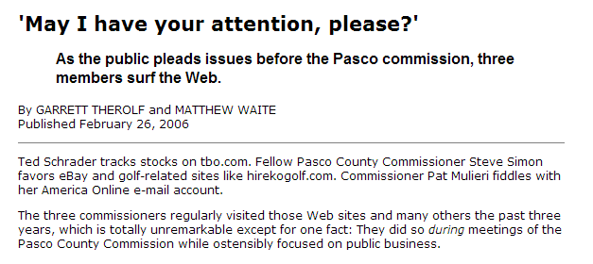

Be a better watchdog
Data: Internet history for all county employees
Notes:
BE A BETTER WATCHDOG: Our job as watchdogs of government requires us to find things that government officials won’t just hand to us in a press release. And to find those things, investigative journalists have long followed the mantra of having a “documents state of mind.” Now that so much government information is stored electronically, we need to have a “data state of mind.” A reporter who can analyze this data is able to open a lot more doors.
This is one of my favorite examples. Reporters at the St. Petersburg Times were wondering what the Pasco County Commissioners were doing during commission meetings. All of them had their heads down, consumed by their laptops. By asking a few questions, the reporters found out that those computers were connected to the county’s network. And the county kept Internet history logs, specific to each user. And yes, those were public records. So the reporters requested the history logs, filtered it down to the commissioners’ user IDs, then filtered it down to the days and times when meetings occurred. Then they looked at which sites the commissioners were visiting and wrote this great – yet rather simple – story telling the readers which sites those commissioners were visiting. And readers could quickly ascertain that it sure didn’t seem like official govt business.

Slide 4
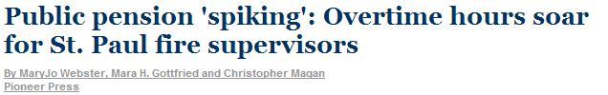
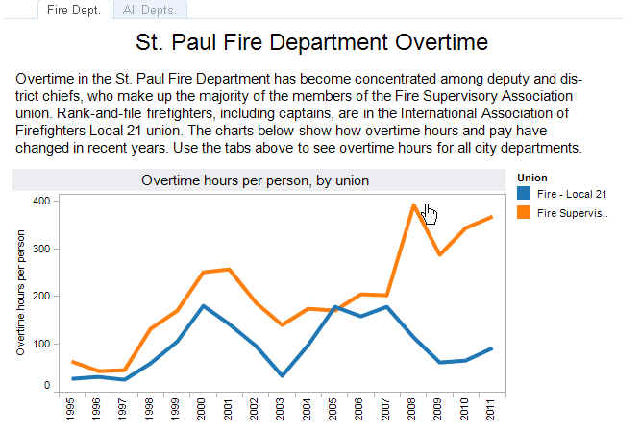

Data:
15 years of city employee salaries
list of retirees by date of retirement
Pension payments
Notes:
Reporter at the St. Paul Pioneer Press had gotten numerous tips over the years that St. Paul firefighters were “spiking” their pensions, by racking up huge amounts of overtime at the end of their career so they would get a larger pension check. But they had a hard time figuring out how to prove that. In 2012, we used city payroll data to show a distinct pattern among a small group of supervisors using extraordinary amounts of overtime. Historical data showed how these supervisors ran up this overtime in their final years, and then pension data showed how their pension checks had ballooned as a result. The findings were something that wouldn’t have been possible through shoe-leather reporting alone.

Slide 5
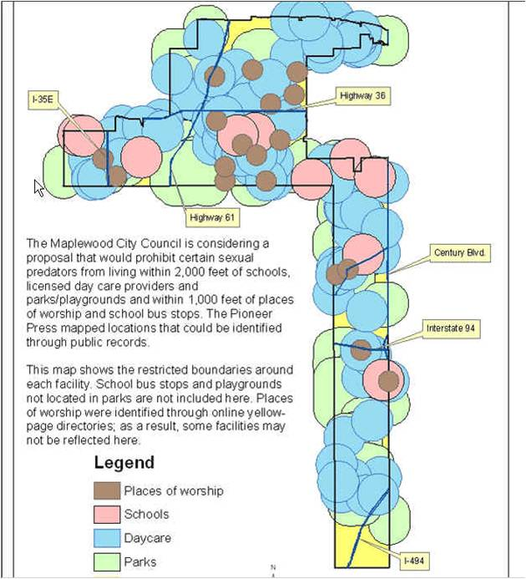
Data: collected either addresses or GIS maps with locations of schools, parks, daycares and places of worship
Notes:
Several years ago, a suburb of St. Paul was considering an ordinance that would’ve prohibited where certain sex offenders could live. The proposal called for banning them from living within 2,000 feet of daycares, schools, parks and playgrounds. And within 1,000 feet of places of worship and bus stops. We used various datasets to find the locations of these places in that city (we didn’t do bus stops or playgrounds) and then used special GIS tools to analyze what portion of the city was left after the restrictions were applied. This map was the result – showing only two small sections of the city unaffected: one was an industrial park in the northern part of the city and the other was under a major interstate highway in the lower part of the city. The following week, the city council tabled the plan and hasn’t brought it back since.

Slide 6

Ask your own questions
Data: Asked every state for data on all newborn screenings done in 2012 * 31 states provided data
Notes:
ASK YOUR OWN QUESTIONS:
By doing our own data analysis, we aren’t confined by the questions that public officials posed and published in their annual reports or press releases. We can ask questions of the data that haven’t been asked.
This is a very large scale example of that kind of thing, but the idea is a simple one….how often are newborn blood screening samples done within the recommended amount of time to help doctors catch potentially life-threatening conditions in newborn babies?
Since nobody else had asked this question – or even collected all the data – the Milwaukee Journal-Sentinel set out to do it themselves. The resulting story showed that a lot of officials were surprised by the answer; they simply didn’t know the answer because nobody had ever asked the question. This resulted in an amazing story that started having an impact even before it published.
This project was very large and not something every paper can do….but think about this concept of asking a question that has never been asked. You can do that with a lot of things – some being quite simple, others being more demanding like this one.

Slide 7
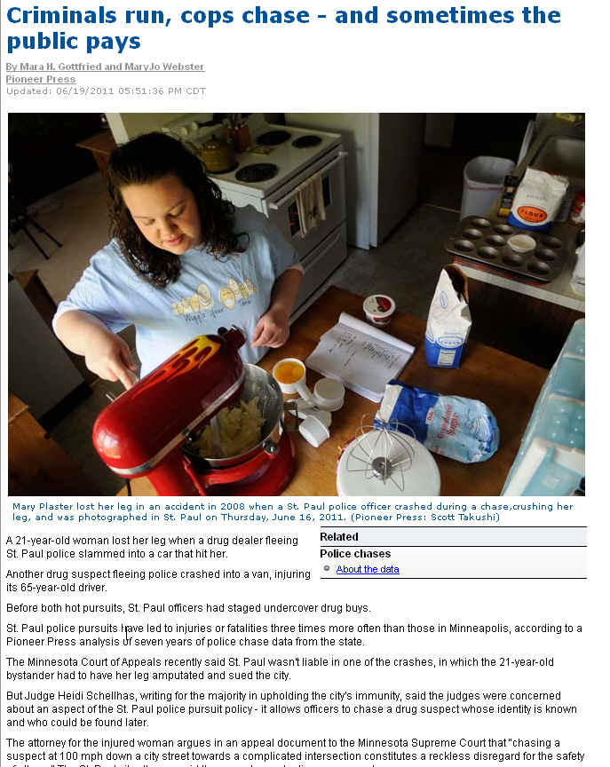
Data: State database with key details on each chase (reported by each agency)
Notes:
At the Pioneer Press, we had a more simple question: How often are bystanders injured or killed as a result of a police chase?
We found that the state kept the data that would answer our question, but they never analyzed the data. So we used the data to show just how rare it is.

Slide 8

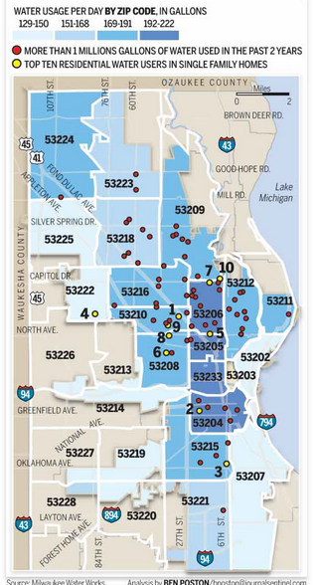
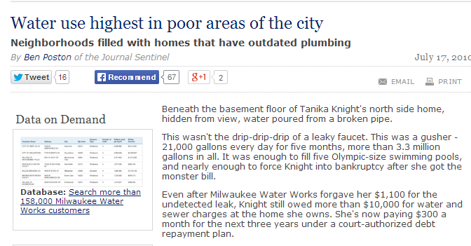
Data: City data on water usage at each address (water billing records)
Notes:
The Milwaukee Journal-Sentinel also asked another interesting question: are there certain parts of the city that use more water than others? (Another way to think of this….are the affluent neighborhoods using a disproportionate share of water because they water their lawns all the time?)
The answer surprised a lot of people: the greatest usage was in the poor areas of the city. Shoe-leather reporting helped them answer why: houses in poor neighborhoods were less likely to have modern toilets, showerheads, etc. that use less water and they were more likely to allow water leaks to go unresolved for longer periods of time.

Slide 9
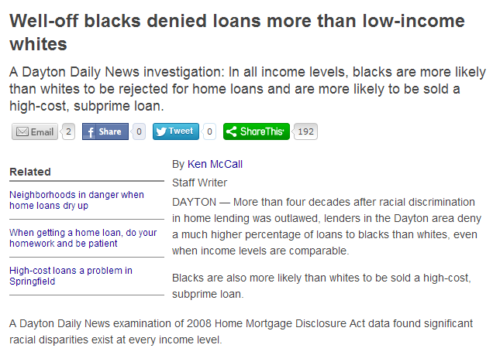

Localize
Data: Home Mortgage Disclosure Act (HMDA) data on all mortgage applications
Notes:
LOCALIZE:
Data also allows us to take a national or statewide trend and ask how it pertains to our local area.
The Dayton Daily News tapped into the Home Mortgage Disclosure Act data, which has details on every home mortgage application, and they looked at whether minorities were more likely to be denied.
They presented their findings in a unique way, too: well-off blacks were denied loans more of than low-income whites.

Slide 10


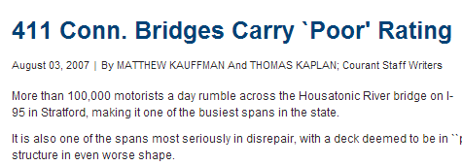
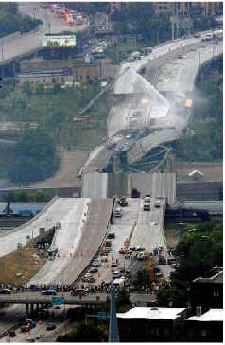
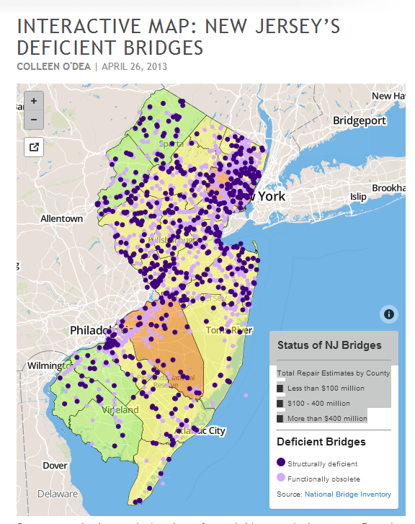
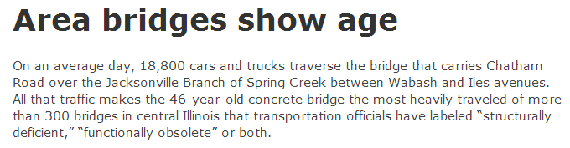

Data: National Bridge Inventory (or state versions)
Notes:
When the 35W bridge collapsed in Minnesota in 2007, news organizations all over the country pulled up bridge inspection data to find out how many “deficient” bridges were in their communities.

Slide 11

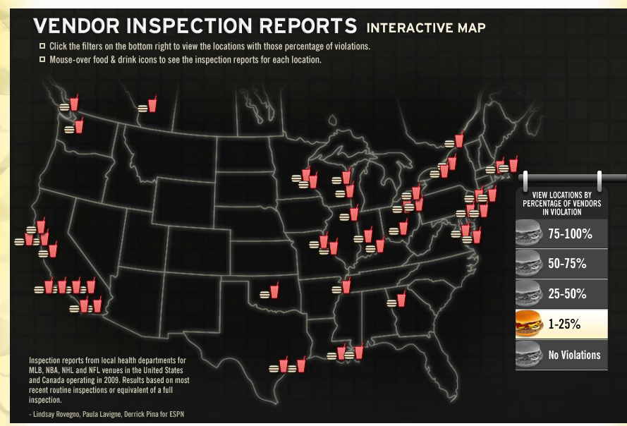
Find hard-to-see patterns or trends
Data: health department inspection reports for 107 pro sports stadiums
Notes:
FIND HARD-TO-SEE PATTERNS OR TRENDS:
Sometimes there are trends or patterns that we can’t prove through any other means than data analysis.
In some cases – like this ESPN story – the data isn’t all compiled in one location for easy analysis. ESPN collected inspection reports for 107 pro sports stadiums around the country and then told readers how the food vendors faired.

Slide 12
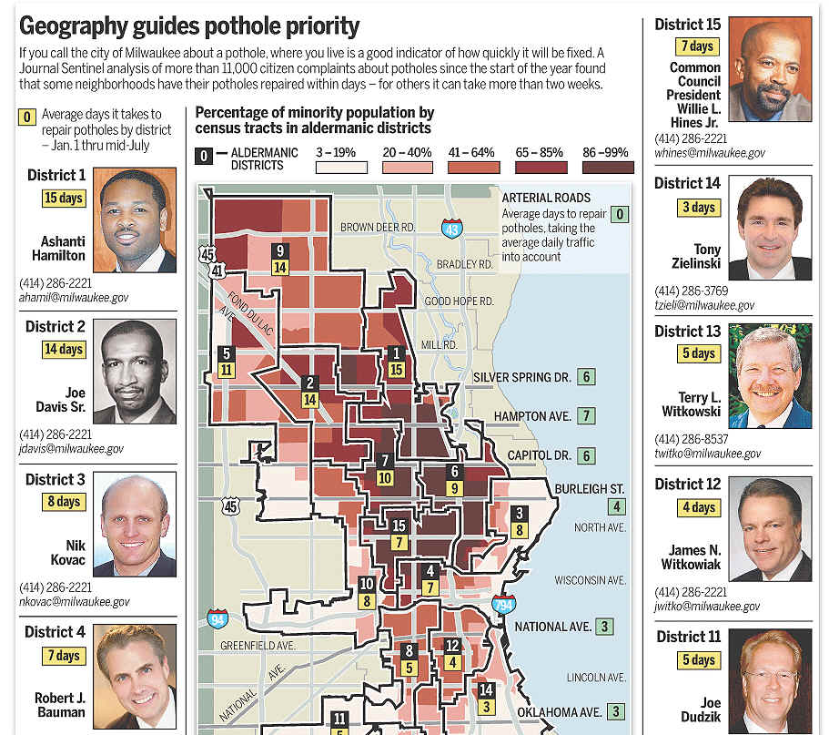
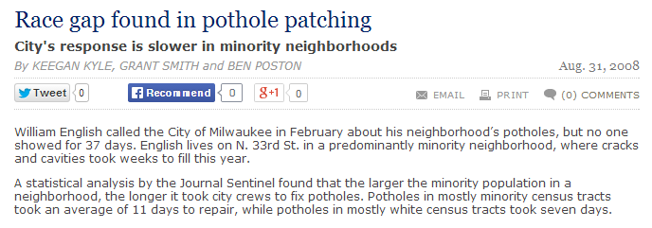
Data: city database tracking pothole complaints and dates they were repaired
Notes:
The Milwaukee Journal-Sentinel put two different datasets together to ask an interesting question --- are potholes taking longer to be fixed in primarily “minority” neighborhoods than in mostly white neighborhoods?
By putting together pothole data and demographic data, they could see a pattern that wasn’t obvious by simply looking at the pothole data.

Slide 13
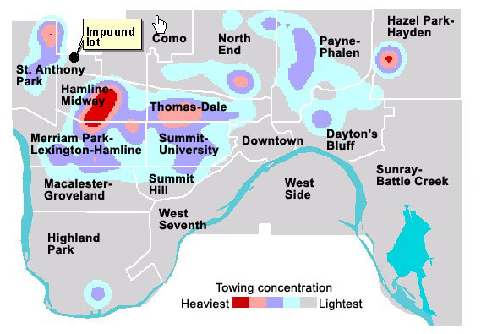
Data: cars towed in violation of snow emergency rules, including address
Notes:
My predecessor at the Pioneer Press and another reporter set out to find out if cars were towed during snow emergencies more often in some neighborhoods than others. She got data listing every car that had been towed during a snow emergency over the last few years, but analyzing the data in a rows and columns format didn’t seem to show anything. She then plotted all the locations in a map – a huge mess of pins on a map. Still nothing. Then she used a GIS analysis technique – commonly called “hot spots” – and immediately found a huge concentration of cars that were towed from the northwest corner of the city. A little shoe-leather reporting pointed them to the fact that this area was very close to the impound lot and had a large concentration of properties that did not have off-street parking. And then they learned that the towing companies had a clause in their contracts with the city saying they would get paid more if they got more cars to the lot each day.

Slide 14
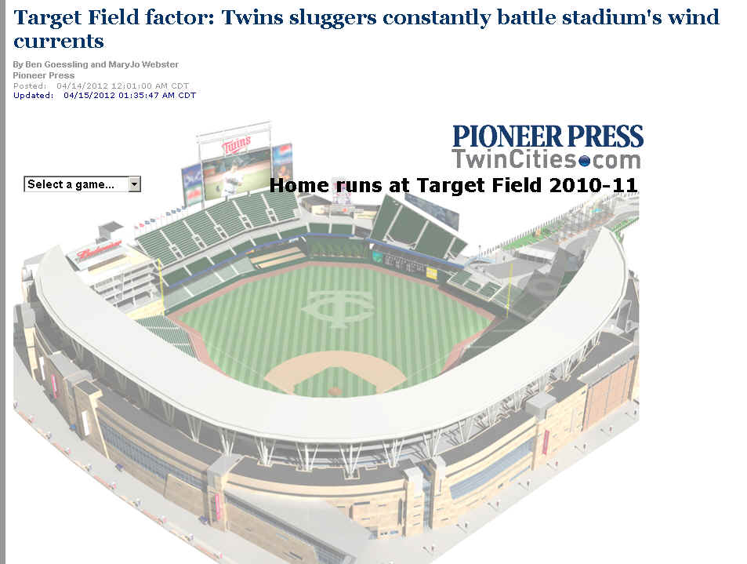
Is it true?
Data:
Hitting data by team for each game
Weather data by day and start time of game
Notes:
IS IT TRUE?
Journalists spend a lot of time writing about whether something is true or not. Most of the time we end up with a lot of “he said she said” -- various people or experts batting around the various opinions or theories.
But sometimes journalists could measure whether something is true or not, using data.
At the Pioneer Press we were getting ready for the third season that the Minnesota Twins baseball team would play in their new stadium, Target Field. The big question everybody was talking about was why the Twins had such a horrible record hitting homeruns those first two seasons. There were tons of theories floating around. But the players all talked about one – the weather.
So the baseball

Slide 15
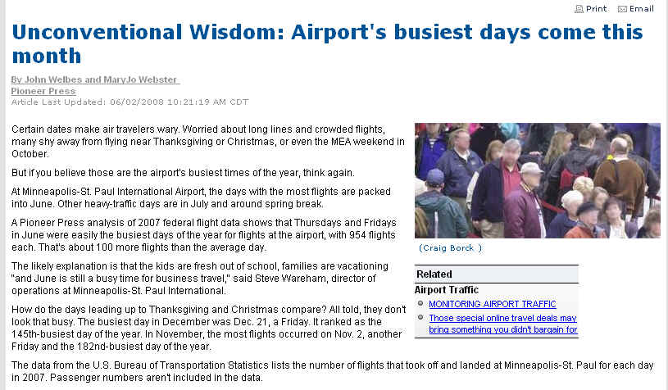
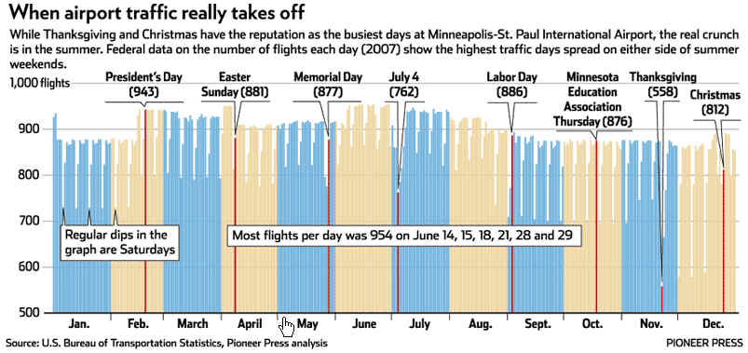
Data: Number of departures and arrivals by airport, by date

Slide 16
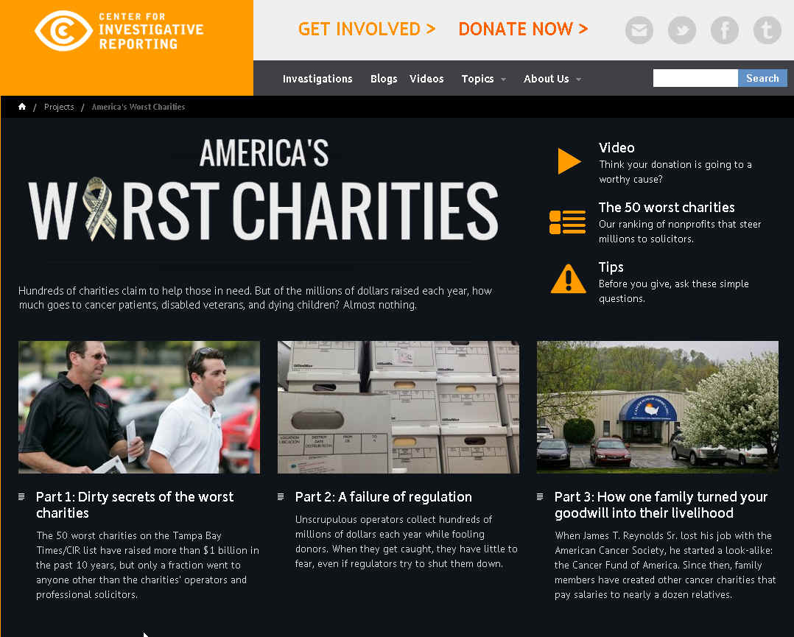
Find all the examples, not just one
Data: IRS 990 forms

Slide 17

Data: Death certificate data

Slide 18
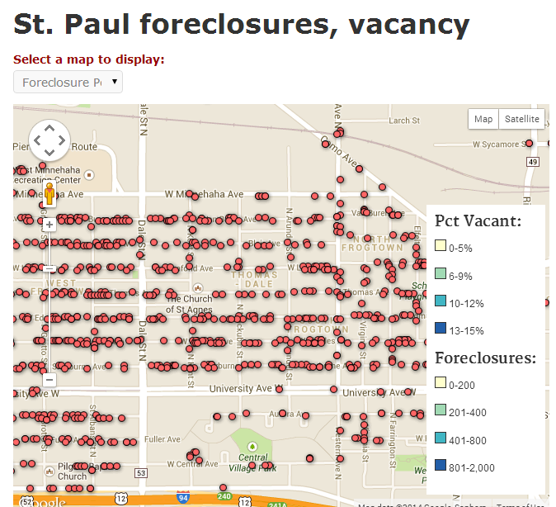
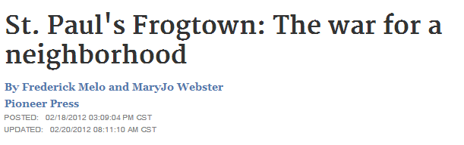
Dig deeper
Data: County sheriff’s sales records

Slide 19

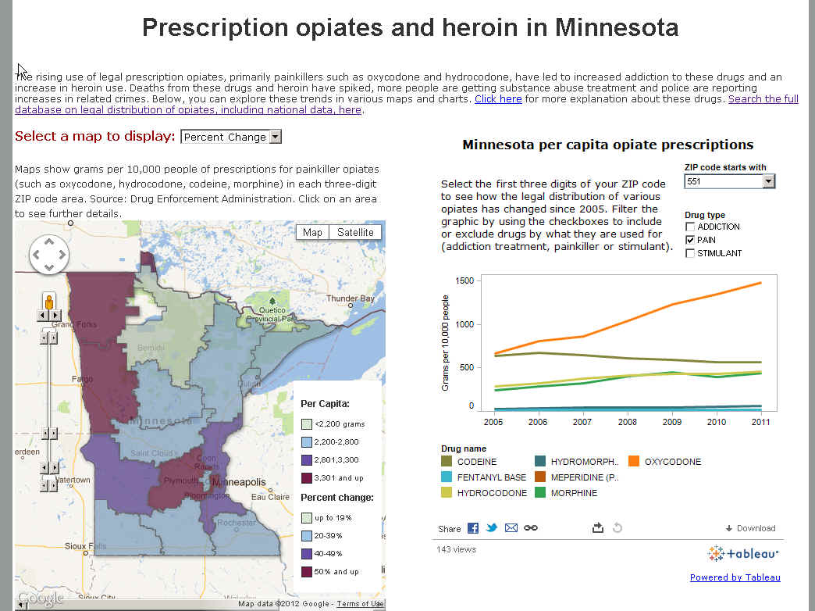
Data: The DEA’s ARCOS data tracking legal distribution of controlled substances

Slide 20


Improve beat reporting
Mila Koumpilova
Pioneer Press
Education

Slide 21
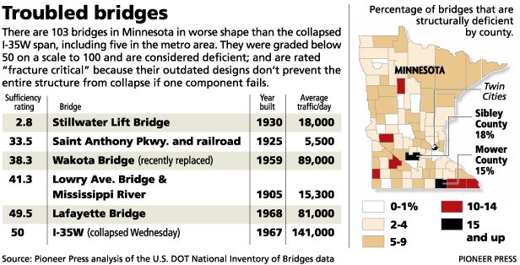
Put big events into context
Data: National Bridge Inventory (or state version)

Slide 22
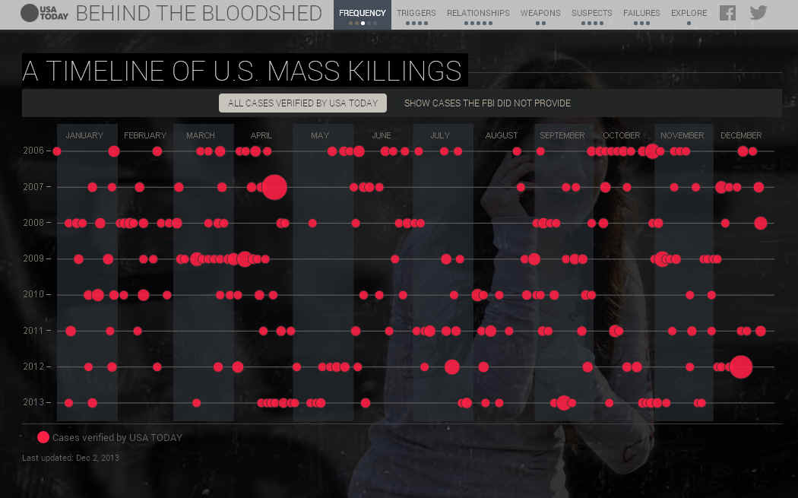

Data:
FBI data
Media reports
Local police records

Slide 23
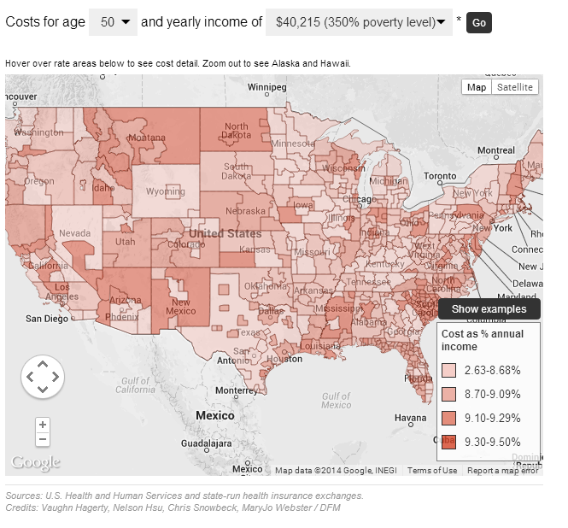
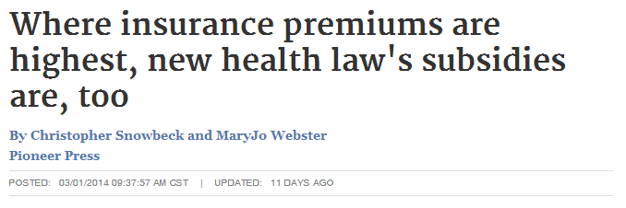
Engage readers
Data: premiums for health insurance policies available in new exchanges

Slide 24
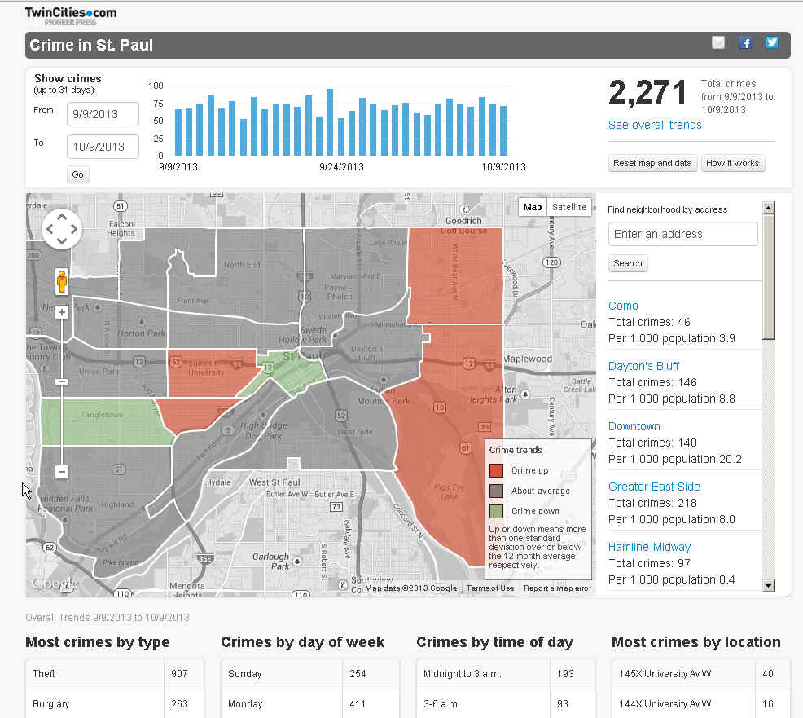
Notes:
You can also use stand-alone data-driven interactives to engage readers. The DFM Data team built crime maps for both St. Paul and Denver. New data flows into these maps on a regular basis, giving readers a great way to keep tabs on crime in their neighborhood. In addition to seeing the overall trends, you can click on a neighborhood and see the actual crimes plotted on the map.

Slide 25
Managing/Editing data journalism

Slide 26

Do you want surgeons?

Slide 27
Encouraging reporters to use data
Seek candidates with data experience
Seek out training – free online courses, DFM training, IRE
Push for data presentation
Beat development: what data sources are on your beat?
Story ideas: What data are you going to use?
Frame story ideas as questions, not nouns

Slide 28


Slide 29
Data is a source

Slide 30

Data should not be your only source

Slide 31

If you ask wrong question, you’ll get wrong answer

Slide 32

If something doesn’t seem quite right, check it out

Slide 33
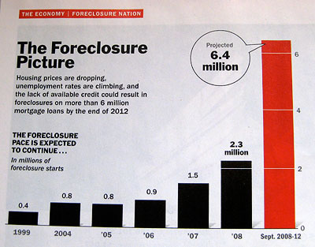
Data can be misleading….

Slide 34

Data can only tell you what it knows

Slide 35

It will often lead you to more questions…

Slide 36
Editing a data-driven story

Slide 37

Back up findings with shoe-leather reporting

Slide 38
Seek outside advice
Have experts on the topic reviewed the methodology and findings?
Have critics reviewed the findings?

Slide 39

Re-run analysis and check the math

Slide 40
Are numbers presented fairly?
Apples to apples comparisons
Use rates when necessary
Adjust for inflation when necessary
Help readers understand really big or really small numbers
“Star” number
Don’t bury your story with numbers
Rely on graphics

Slide 41

How Thunderdome can help
Contact us early in the process!
Story generation; data acquisition, analysis & cleaning
Build an interactive
Training
Monthly “community call”
Join DFM data Google Group
Notes:
There are a lot of potential ways the Thunderdome Data Team can help your newsroom. The main thing to know is that we’re not always going to be able to help, but we are very eager to try. The best approach is to contact us as early in the process as possible. Contacting Data Team Editor Tom Meagher is the best route to go and he’ll figure out if someone on the team is capable and available to help.
We also are doing a lot of training. Earlier this month, I launched a monthly “community call” where we will offer a variety of data-related topics. Next month we’ll have a virtual demo of a great new data site, CensusReporter.org, that has made census data much more accessible for reporters.
We will be offering other virtual training opportunities in the coming months, and we are also available to come into your newsroom.
And finally, anyone in your newsroom working with data regularly should join our DFM data Google group.

Slide 42

MaryJo Webster
mwebster@digitalfirstmedia.com
@MaryJoDFM

